Slide 1
Flocking
Concordia University | COMP 476 - Lab
Lab Slides created by Daniel Rinaldi

Slide 2
Flocking
Concordia University | COMP 476 - Lab
Lab Slides created by Daniel Rinaldi
Flocking is a behavior very closely resembling shoals of fish or flocks of birds. We call an AI agent that is part of a flock a “boid” (bird-like object). All the boids in a flock can be moving in one direction at one moment, and then the next moment the tip of the flock formation can turn and the rest of the flock will follow as a wave of turning boids propagates through the flock.
Craig Reynolds’ implementation is leaderless in that no one boid actually leads the flock; in a sense they all individually sort of follow the group, which seems to have a mind of its own. The motion Reynolds’ flocking algorithm generated is quite impressive. Even more impressive is the fact that this behavior is the result of three simple rules:
Cohesion: Have each unit steer toward the average position of its neighbors.
Alignment: Have each unit steer so as to align itself to the average heading of its neighbors.
Avoidance: Have each unit steer to avoid hitting its neighbors.
It’s clear from these three rules that each unit must be able to steer, for example, by application of steering forces.
Furthermore, each unit must be aware of its local surroundings, it has to know where its neighbors are located, where they’re headed and how close they are to it.

Slide 3
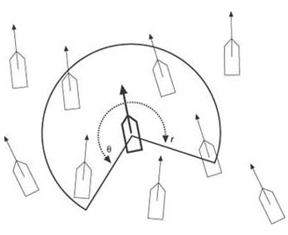
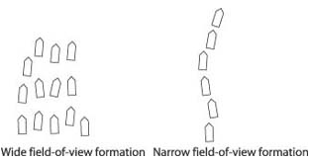
Neighbor Awareness
Concordia University | COMP 476 - Lab
Lab Slides created by Daniel Rinaldi
In order for an agent to be aware of its neighbors, we need to first determine what a neighbor is or more specifically how we are going to detect our neighbors. To what extent is each unit aware of its neighbors?
Basically, each unit is aware of its local surroundings, meaning that it knows the average location, heading, and separation between it and the other units in the group in its immediate vicinity. The unit does not necessarily know what the entire group is doing at any given time.
The way that we detect the local neighbors of a given agent is by using a field of view with a limited distance. Note that some flocking algorithms use a 360-degree field of view because it is easier to implement, however this
will affect the quality of the resulting flocking behavior.
A more common implementation for the field of view is to use a visibility arc of radius r around the given unit. The unit can see all other units that fall within that arc. The visible units are used when applying the flocking rules; all the other units are ignored. The visibility arc is defined by two parameters, both affect the resulting flocking motion, and you can tune them to fit your needs:
The arc radius, r measures the visible distance of the field of view.
The angle, θ measures the width of the field of view.
In general, a larger radius will allow the unit to see more of the group, which results in a more cohesive flock. That is, the flock tends to splinter into smaller flocks less often because each unit can see where most or all of the units are and steer accordingly.
In general, a wider angle results in relatively well formed flocks. A narrow angle results in flocks that tend to look more like a line of ants walking along a path.

Slide 4
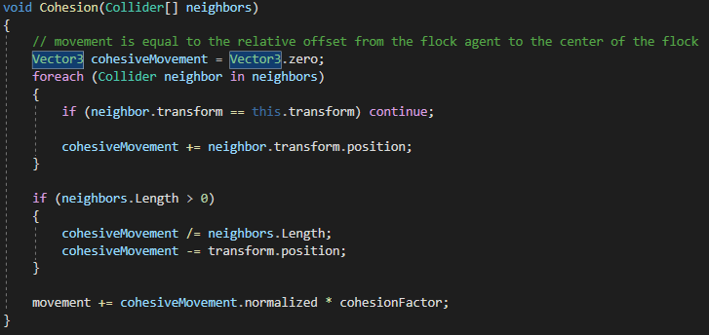
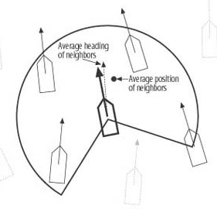
Cohesion
Concordia University | COMP 476 - Lab
Lab Slides created by Daniel Rinaldi
Cohesion implies that we want all the units to stay together in a group. We don’t want each unit breaking from the group and going its separate way. To satisfy this rule, each unit should steer toward the average position of its neighbors. The figure on the bottom right illustrates a unit surrounded by several neighbors.
The average position of neighbors is fairly easy to calculate. Once the neighbors have been identified, their average position is the vector sum of their respective positions divided by the total number of neighbors (a scalar). The result is a vector representing their average position.

Slide 5
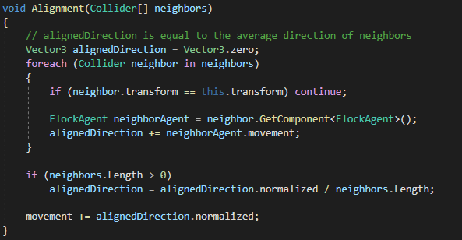
Alignment
Concordia University | COMP 476 - Lab
Lab Slides created by Daniel Rinaldi
Alignment implies that we want all the units in a flock to head in generally the same direction. To satisfy this rule, each unit should steer so as to try to assume a heading equal to the average heading of its neighbors. Referring to the figure in the bottom right, the bold unit in the center is moving along a given heading indicated by the bold arrow attached to it. The light, dashed vector attached to it represents the average heading of its neighbors. Therefore, for this example, the bold unit needs to steer toward the right.
In Unity, we can use each unit’s forward vector to determine its heading but generally it’s better to use the unit’s current velocity.

Slide 6
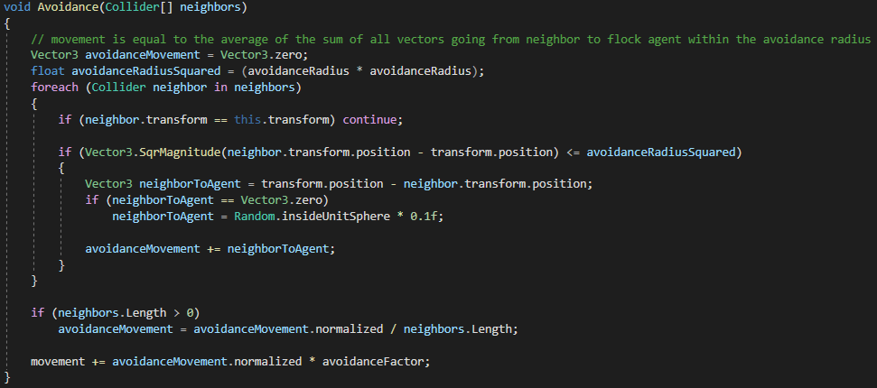
Avoidance
Concordia University | COMP 476 - Lab
Lab Slides created by Daniel Rinaldi
Avoidance implies that we want the units to maintain some minimum distance away from each other, even though they might be trying to get closer to each other as a result of the cohesion and alignment rules. We don’t want the units running into each other or, worse yet, coalescing at the same position. Therefore, we’ll enforce avoidance by requiring the units to steer away from any neighbor that is within view and within a minimum distance (avoidance radius).
When comparing the magnitude of the vector going from neighbor to our self with the avoidance radius, it is better to just compare the squared magnitude with the square of the avoidance radius. This avoids having to calculate the normal magnitude which requires us to do a square root (more expensive).

Slide 7
Tasks
Concordia University | COMP 476 - Lab
Lab Slides created by Daniel Rinaldi
Flocking Behaviors
Using the provided scripts, implement the following flocking behaviors. The behaviors should be implemented locally to each agent and can either use kinematic or dynamic movement (up to you).
Cohesion : Have each unit steer toward the average position of its neighbors.
Alignment : Have each unit steer so as to align itself to the average heading of its neighbors.
Avoidance : Have each unit steer to avoid hitting its neighbors.
Seek : Have each unit steer towards a given target.
You will have to play with the settings (cohesionFactor, avoidanceFactor, seekSpeed) and thus they should be used in your algorithms.
If you have the time, you can also try to implement the following:
“Birds of a feather, flock together!” : Have more than one flock in the scene at the same time. Each flock should disregard neighbors of another and only take into consideration boids of the same flock.
Obstacle avoidance : Add more rocks to the scene. Have the boids avoid colliding with the added rocks.

Slide 8
Thank You
Concordia University | COMP 476 - Lab
Lab Slides created by Daniel Rinaldi

Slide 9
Other Links
https://docs.unity3d.com/2020.3/Documentation/Manual/index.html
https://docs.unity3d.com/2020.3/Documentation/Manual/ExecutionOrder.html
Concordia University | COMP 476 - Lab
Lab Slides created by Daniel Rinaldi

